Slide 1
Depth Study 2: Equality and Difference

Slide 2
The Nature of Equality and Difference
Students develop an understanding of the nature of equality and difference through:
S: considering the nature of difference in societies and cultures, including the hybrid nature of societies and cultures.
As we are all unique individuals it is very easy to understand the nature of difference between persons. (physical, biological, mental, social, cultural including ethnicity, language, traditions, rituals)
Australia is a hybrid society. Meaning, Australian society contained a mixture or combination of people from different ethnicity, religion, disability, sexuality.
Historically, societies have been relatively homogenous or similar, tolerating very little difference or deviations from the norm.
However, today as a result of globalisation many nations around the world can be identified as either hybrid, multicultural OR both.

Slide 3
Australian Multiculturalism
See PowerPoint ‘Census in Multicultural Australia’ 2011.

Slide 4
Commonality and Difference in societies and cultures
S: considering aspects of commonality and difference in societies and cultures
Commonality refers to aspects of humanity that we all share. E.g. emotion, basic needs etc
Social differentiation: is the process by which members of society are categorised in terms of ethnicity, sex, age, income, employment and education. In these terms both physical and cultural differences are used to construct a perceived ‘higher’ status, prestige or wealth in society.
Example: Socioeconomic status in Australia.

Slide 5
Social class and Socioeconomic status in Australia
Social class: a system in which most societies are organised into hierarchical levels, based upon power, privilege and wealth. Upper, middle and lower class are the most often identified.
Socioeconomic status: is a measure used to compare people or groups based on social and economic data such as income, employment and residential location.

Slide 6
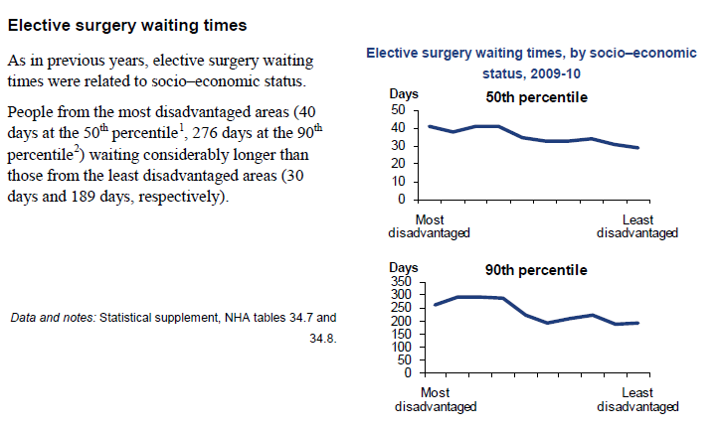
Report to the Council of Australian Governments, April 2012

Slide 8
Unequal Access to SVR
S: considering unequal access to socially valued resources for health care, housing, education, employment and the justice system
*Access to SVR are those resources considered to be the ‘essentials of life’ in Australia today. Mission Australia (2006) found these results from 61 survey participants.
Highest priorities: Access to medical treatment, ability to buy medicines, access to dental treatment, warm clothes, bedding, a substantial meal at least once a day.
Lowest priorities: heating in at least one room of a dwelling, a public telephone, beds for children, washing machine.

Slide 9
Unequal access goes against the Australian cultural concept of an egalitarian society. This means, a society in which there is a ‘fair go’ for all citizens, It generally means a society of equal opportunities.
Access to SVR can be denied through the process of discrimination. It is based upon prejudice and is any act or action carried out by a person or group against another based on prejudicial ideas. It can be direct or indirect.

Slide 10
S: the meaning of equality
In order to understand the concept of equality, we need to distinguish between equal access to socially valued resources and the outcomes of such access.
Equality: equal access to socially valued resources such as education, housing, health, employment and the justice system.
Equity: everyone gets the same amount, fairness.

Slide 11
S: the extent to which the ideal of equality is shared by all Australians
Traditionally, many Australians believed we lived in the land of the ‘fair go’ for all. However, has this ever been the case and do you believe all Australians get a ‘fair go’ today?
Egalitarian: A society in which there is a ‘fair go’ for all citizens. It generally means a society of equal opportunity.

Slide 12
S: inequality and its consequences, by examining different outcomes experienced by people including: People with a Disability
ABS: Disability Australia, 2009
This publication presents summary results relating to people with disabilities from the 2009 Survey of Disability, Ageing and Carers (SDAC).
The survey was conducted by the Australian Bureau of Statistics (ABS) from April to December 2009. The primary objective of the survey was to collect information about three population groups:
- people with disabilities;
- older people, that is those aged 60 years and over; and
- people who provide assistance to older people and people with disabilities.

Slide 13
The Survey of Disability, Ageing and Carers (SDAC) defines disability, not by the conditions that a person may have, but by the disruption these conditions cause to their daily living. The survey definition states that: ‘a person has a disability if they report they have a limitation, restriction or impairment, which has lasted, or is likely to last, for at least six months and restricts everyday activities’ (Disability, Ageing and Carers, Australia: Summary of Findings, 2009).

Slide 14
Just under one in five Australians (18.5% or 4.0 million persons) reported having a disability in 2009.
A further 21% had a long-term health condition that did not restrict their everyday activities.
The remaining 60% of the Australian population had neither a disability nor a long term health condition.
Of those with a disability, 87% had a specific limitation or restriction; that is, an impairment restricting their ability to perform communication, mobility or self-care activities, or a restriction associated with schooling or employment.
The prevalence of disability in Australia has fallen 1.5 percentage points from 20.0% in 2003 to 18.5% in 2009.

Slide 15
Categories of Disability
In the SDAC, disability is described by levels of severity. Of all people with disability, most (87%) had specific restrictions. This meant that they had limitations in one or more of the everyday core activity areas of self-care, mobility and communication or that they had a schooling or employment restriction. The remainder (13%) had disability that did not cause a specific limitation or restriction considered in the SDAC. The four levels of limitation are defined as follows: 1. Profound - the person is unable to do, or always needs help with, a core activity task. 2. Severe - the person:
sometimes needs help with a core activity task
has difficulty understanding or being understood by family or friends
can communicate more easily using sign language or other non-spoken forms of communication.
3. Moderate - the person needs no help, but has difficulty with a core activity task. 4. Mild - the person needs no help and has no difficulty with any of the core activity tasks, but: uses aids and equipment
cannot easily walk 200 metres
cannot walk up and down stairs without a handrail
cannot easily bend to pick up an object from the floor
cannot use public transport
can use public transport, but needs help or supervision
needs no help or supervision, but has difficulty using public transport.

Slide 16
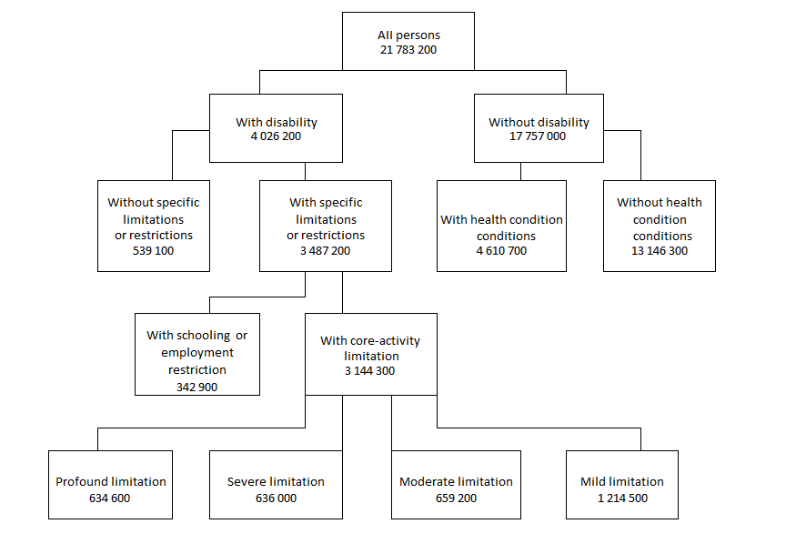

Slide 17
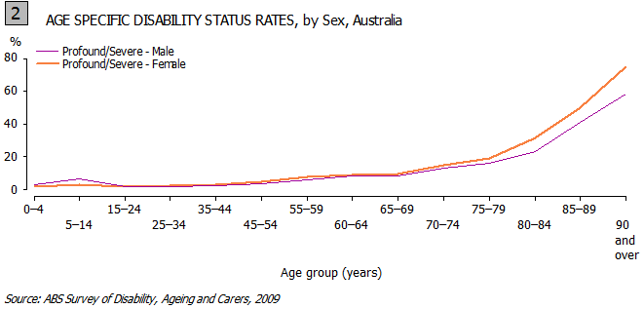
Differences in Age and Sex
There was no significant difference in the overall rates of disability between males (18%) and females (19%), but there were significant differences across age/sex groups.
Males aged 5-14 years had higher rates of profound or severe core-activity limitation (6.6%) compared to females of the same age (3.0%).
For people in their 70s however, this pattern had reversed and of those aged 85 years or over, women had significantly higher rates of profound/severe core-activity limitation (58%) than men (45%) in the same age bracket.

Slide 18
The main conditions
The main conditions associated with disability in 2009 were back problems (15.6%), arthritis (14.8%), hearing loss (6%), leg damage from injury/accident (3%), depression (3%) and asthma (3%). The main conditions associated with profound/severe disability were similar: back problems (13.0%), arthritis (12.8%), dementia (4.0%), autism and related disorders (3.2%), depression (3.1%) and stroke (3.1%). CHILDREN WITH SCHOOLING RESTRICTIONS Approximately 230,000 children aged 5-20 years had a schooling restriction in 2009. Of these children: 3% had a profound schooling restriction (unable to attend school);
49% had a severe schooling restriction (attended special school/classes);
46% had a moderate schooling restriction (needed time off school, had difficulty at school or needed special assessment procedures); and
2% had a mild schooling restriction (used special computer/equipment, had special transport or access arrangements).

Slide 19
Has the need for assistance changed since 2003?
When interpreting disability statistics it is important to note that although there was a decrease in the prevalence of disability between 2003 (20.0%) and 2009 (18.5%), there was an actual increase in the estimated number of people with disability from 2003 (3,958,300) and 2009 (4,026,213).

Slide 21
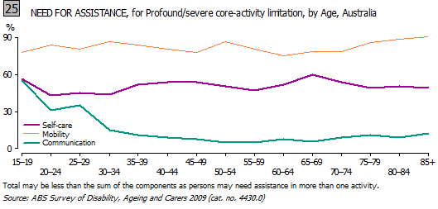
Age and need for assistance
In 2009 there were 1.0 million people with profound or severe core-activity limitations living in households. These people had the greatest need for assistance with core-activities, but both age and the level of disability appeared to have an impact on the need for assistance (Graph 25). Young people had significantly higher need for assistance with communication than older people. Of all 15-19 year olds with profound/severe core-activity limitation, 55% reported need for assistance with communication while only 12% of those aged 85 years and over reported the same. In the case of younger people, this was likely to be because of communication disorders such as autism or developmental delay. Amongst older people, however, a higher proportion of the communication problems were more likely to relate to the onset of age-related hearing problems and dementia related conditions.

Slide 22
Children and the need for assistance
In 2009, a set of age appropriate questions on need for assistance with core-activity tasks was asked about children aged 0-4 years with a disability. In addition, all children with disability aged 14 years and under were asked a set of age appropriate questions relating to cognitive and emotional support. Graph 26 shows the results for each of the areas of interest: Communication This was the most dominant area of need for assistance amongst children. Of all children aged 5-9 years with profound severe disability, 73% needed assistance with communication. Early intervention strategies may account for the slight decrease in need for assistance for children aged 10-14 years (65%). Cognitive/emotional tasks There was a steep rise in need for assistance with cognitive tasks for children with profound or severe disability between the ages of 0-4 years (49%) and 5-9 years (70%). This is possibly because signs of developmental delay become more apparent in a school environment focused specifically on the development of cognitive ability, and are therefore reported more often.

Slide 23
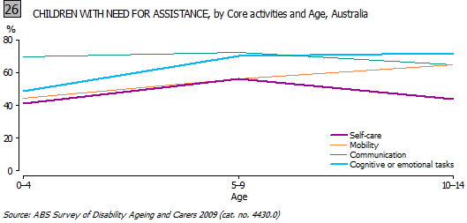
Mobility There was a steady increase in need for assistance with mobility. Of children aged 0-4 years with profound/severe core activity limitation, 44% needed assistance with mobility compared to 56% of those aged 5-9 years and 65% of those aged 10-14 years. As children grow in height and weight, it is possible that degenerative conditions affecting their mobility become more pronounced. The desire to be mobile also increases at this time, increasing the need for assistance. Self-care Children aged 5-9 years with profound or severe core-activity limitations generally had higher need for assistance with self-care (56%) than children aged 0-4 years (41%) or those aged 10-14 years (44%). There are possibly several reasons: the early years of school (0-5 years) mark a transition from home to school where developmental delay becomes more apparent without the constant support of parents;
in the early months of life, children are usually under the care of parents and it is possibly difficult to whether their dependency is related to being young or having a disability. The impact of a disabling condition may not be fully apparent during these years; and
the decrease in need for assistance for children aged 10-14 years is possibly a result of their learning to manage some aspects of self-care better, often as a result of previous assistance.

Slide 24
Access and outcomes in Education
Learning skills is one of the six policy areas highlighted in the National Disability Strategy, in acknowledgement of: 'A significant gap between students with disability and those without, notably in the attainment of Year 12 or equivalent, vocational education and training qualifications, and participation in university studies. Targeted support is needed to assist people who are disadvantaged in education and in the workforce, but mainstream education programs need to be designed for people of all abilities.' ⁴ The United Nations Convention on the Rights of Persons with Disabilities also addresses the rights of people with disabilities to access education. Article 24 notes signatories should ensure that: 'Persons with disabilities can access an inclusive, quality and free primary education and secondary education on an equal basis with others in the communities in which they live.' ⁷

Slide 25
The number of people completing Year 12 provides a measure of whether people are continuing to study to the end of schooling opportunities. People with schooling or employment restrictions only are those who need extra support in their schooling or occupation because of their disability, but who do not fall into any of the other disability status categories. In 2003, 49% of people without disability aged 15-64 years who were living in households, had completed Year 12. In 2009, there was an improvement with 55% of this same cohort completing Year 12. However, the same degree of improvement in school retention rates was not evident for people with profound or severe core-activity limitations. In 2003, 24% of this cohort had completed Year 12. In 2009, 25% had completed Year 12 (roughly one quarter the rate of improvement experienced by those with no disabilities).

Slide 26
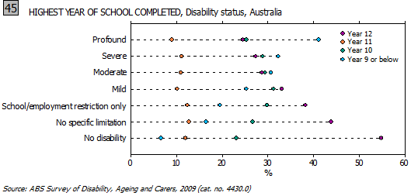

Slide 27
Labour Force access and participation
According to The National Disability Strategy (2011): Work is essential to an individual's economic security and is important to achieving social inclusion. Employment contributes to physical and mental health, personal wellbeing and a sense of identity. Income from employment increases financial independence and raises living standards. ⁴ The economic independence employment brings is also important as it helps people with disabilities to exercise more choice in their lives, aids them to live independently and facilitates their inclusion in the community. These are all issues covered in the United Nations Convention on the Rights of Persons with Disabilities. Article 27 of the United Nations Conventions also recognises: the right of persons with disabilities to work, on an equal basis with others; this includes the right to the opportunity to gain a living by work freely chosen or accepted in a labour market and work environment that is open, inclusive and accessible to persons with disabilities ⁷.

Slide 28
Labour force outcomes for people with disabilities remained below this UN target in 2009. Of those aged 15-64 years and living in households, 54% were participating in the labour force, compared to 83% of the non-disabled population. Women with disabilities were particularly affected, with a participation rate of 49%, well below the 60% participation rate of males with disabilities and the 77% participation rate of females without disabilities. A person’s disability status factored heavily into whether or not they were likely to be participating in the labour force. Those with a profound level of core activity limitation had a labour force participation of 17%, much lower than the participation rate of the non-disabled population

Slide 29
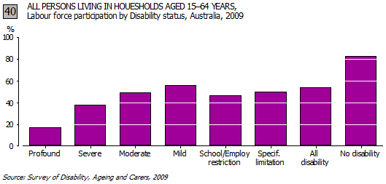

Slide 30
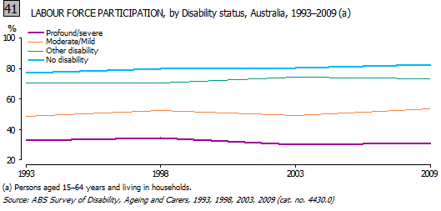

Slide 31
Restrictions of choice (type of job/full time and part-time)
Of those people aged 15-64 years who were living in households and had disabilities, over 51% reported being restricted in the type of job they can do. In terms of other employment restrictions experienced by people with disabilities, 30% reported they were restricted in the number of hours they could work and 41% reported having difficulty changing jobs or getting a preferred job.
When people with disabilities were employed and required an average of one day a week away from work because of their condition, the type of arrangements they used were influenced by whether they worked full-time or part-time. People working part-time most often reported using ‘flexible hours’ to accommodate the time off they needed (53%), while those working full-time were most likely to report 'sick leave' (35%).

Slide 32
S: Examine ways to reduce inequality
legislation introduced to reduce inequality – local, national and global
• affirmative action policies
• community initiatives
• welfare systems

Slide 33
Government Legislation
1 Short title
This Act may be cited as the Disability Discrimination Act 1992.
2 Objectives
The objectives of this Act are:
(a) to eliminate, as far as possible, discrimination against persons on the ground of disability in the areas of:
(i) work, accommodation, education, access to premises, clubs and sport; and
(ii) the provision of goods, facilities, services and land; and
(iii) existing laws; and
(iv) the administration of Commonwealth laws and programs; and
(b) to ensure, as far as practicable, that persons with disabilities have the same rights to equality before the law as the rest of the community; and
(c) to promote recognition and acceptance within the community of the principle that persons with disabilities have the same fundamental rights as the rest of the community.

Slide 34
Affirmative Action Policies
Affirmative action is more commonly known as positive discrimination. That is, discrimination that aims to reverse past wrongs or compensate and improve the position of the victims of discrimination unequal access to resources.
E.g. Nova Employment ‘Focus on Ability’
http://www.novaemployment.com.au/

Slide 35
Community Initiatives
Look for own example…e.g. non-government organisations

Slide 36
Welfare Systems
National Disability Insurance Scheme (2012)
What is an NDIS?
Depending on life’s chances, any one of us could be living with a permanent disability that significantly reduces our ability to independently care for ourselves. On average, every 30 minutes someone in Australia is diagnosed with a significant disability.
Yet in Australia, we have a cruel lottery where the services and support people with disability, their families and carers receive depends on where they live, what disability they have, and how they attained that disability.
As the Productivity Commission found, while there are pockets of success in some states, no disability support arrangements in any state or territory are working well in all areas.
This is despite the enormous effort of disability workers on the ground helping to provide support and services to people with disability, their families and carers, and with funding from all levels of government.
Instead, people with disability are caught in a system that responds to crisis; a system that drips out support rather than invests in someone’s future. A system that is failing.
The Prime Minister released the Productivity Commission’s report on 10 August 2011 and all governments agreed with the recommendation to establish a National Disability Insurance Scheme (NDIS).
An NDIS will turn the way we currently provide disability services on its head. Rather than funding based on historical budget allocations, a funding pool will be based on actuarial assessment of need.

Slide 37
It will recognise that disability is for a lifetime, and so it will take a lifelong approach to providing care and support. This means that assessment will look beyond the immediate need, and across the course of a person’s life. For example, home modifications might be expensive up front, but if they afford a person with significant disability the opportunity of greater independence, or if they mean that a parent carer can continue to care for their loved one, it’s a good investment.
Taking a lifelong approach also means focusing on intensive early intervention, particularly for people where there is good evidence that it will substantially improve functioning or delay or lesson a decline in functioning.
Importantly, an NDIS will support choice for people with disability, their families and carers, and put people in control of the care and support they receive, based on need. Of course, there will also be safeguards in place to support people in exercising this choice and control, and to help them make informed choices.
An NDIS will ensure people are no longer “shut out” from opportunities and from independence by providing the appropriate and necessary supports that allow people with disability to reach their full potential.
It will nurture and sustain the support of families, carers and friendship groups — the very communities of support that are critical to improving the lives of people with disability.
And it will include a comprehensive information and referral service, to help people with a disability who need access to mainstream, disability and community supports.
A National Disability Insurance Scheme will give all Australians the peace of mind to know that if they have or acquire a disability that leaves them needing daily assistance with everyday life, or if they care for someone who has a disability, that they will be supported.

Slide 38
What has been done so far?
The Australian, state and territory governments started work immediately in building an NDIS. Progress to date includes:
Establishing a Select Council of Treasurers and Disability Services Ministers on Disability Reform to drive development of an NDIS. The Select Council is supported by an Advisory Group.
The Government has appointed four expert groups to work under the Advisory Group to guide the more technical requirements of scheme design. Expert groups have been set up to guide: eligibility and assessment, quality and safeguards, sector and workforce capacity and a national approach to control and choice of an NDIS.
The Australian Government committed $10 million to support the technical work required to lay the foundations for a launch of an NDIS Scheme. This is allowing the governments to work together to build the critical components, taking into consideration issues such as funding, governance, eligibility, assessment, quality standards and workforce and sector capacity.
The Australian Government committed an additional $10 million for projects that examine what needs to be done so that service providers and their workers are able to deliver individual, personalised care, where people with disability and their families and carers have genuine control over the support provided to them.
The Australian Government committed $1 billion to support the first stage of an NDIS from July 2013.
The Australian Government announced a dedicated agency that will manage the implementation of the first stage of an NDIS.

Slide 39
S: Examine individual and group commonality and difference:
the similarities that exist between people from different social and cultural groups
the perception of groups by other groups within society
influences on individuals’ perceptions of others
how members of groups see themselves
how attitudes of group members towards other groups influence behaviour
the role and influence of historical, political and legal forces in the generation and maintenance of social inequality, prejudice and discrimination in Australian society and culture
the extent to which inequality is institutionalised
Make notes on the above points using the Four Corners, Feb 2010 Episode: Breaking Point
http://www.abc.net.au/4corners/special_eds/20100215/disability/

Slide 40
S: The Future
Consider possible futures for equality and difference in the focus study society
evaluating continuity and change in relation to equality and difference
what are the possible futures if existing inequalities are maintained?
how can people with widely divergent viewpoints work together cooperatively?
how can desirable outcomes be achieved for all persons?
what can individuals and groups do to help achieve desirable outcomes?
Use the above syllabus points to guide further research into the future of disability in Australia.
A good starting point could be the Insight (SBS) episode Breaking Point
http://www.sbs.com.au/insight/episode/overview/495/Breaking-Point

